Slide 1
Blacktown Chinese Christian Church
Welcome to Our English Service 10.05.2026
English Service 9:45 – 11:00 am
Worship Songs: Passage: Speaker: Topic: Response Song: Announcements and Closing Prayer Benediction
nan John 11:1-45 Matt Kang I am the Resurrection and the Life

Slide 2
BCCC english service

Slide 3
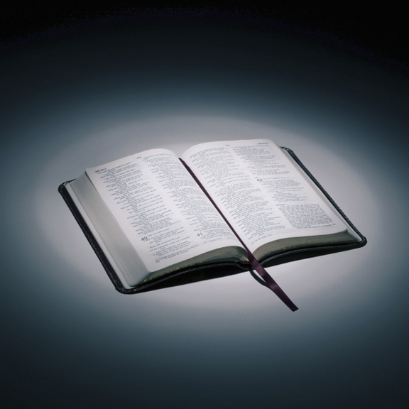
Bible reading

Slide 4
John 11:1-45
Now a man named Lazarus was sick. He was from Bethany, the village of Mary and her sister Martha. ² (This Mary, whose brother Lazarus now lay sick, was the same one who poured perfume on the Lord and wiped his feet with her hair.)

Slide 5
John 11:1-45
³ So the sisters sent word to Jesus, “Lord, the one you love is sick.”
⁴ When he heard this, Jesus said, “This sickness will not end in death. No, it is for God’s glory so that God’s Son may be glorified through it.”

Slide 6
John 11:1-45
⁵ Now Jesus loved Martha and her sister and Lazarus. ⁶ So when he heard that Lazarus was sick, he stayed where he was two more days,

Slide 7
John 11:1-45
⁷ and then he said to his disciples, “Let us go back to Judea.”
⁸ “But Rabbi,” they said, “a short while ago the Jews there tried to stone you, and yet you are going back?”

Slide 8
John 11:1-45
⁹ Jesus answered, “Are there not twelve hours of daylight? Anyone who walks in the daytime will not stumble, for they see by this world’s light. ¹⁰ It is when a person walks at night that they stumble, for they have no light.”

Slide 9
John 11:1-45
¹¹ After he had said this, he went on to tell them, “Our friend Lazarus has fallen asleep; but I am going there to wake him up.”
¹² His disciples replied, “Lord, if he sleeps, he will get better.”

Slide 10
John 11:1-45
¹³ Jesus had been speaking of his death, but his disciples thought he meant natural sleep.
¹⁴ So then he told them plainly, “Lazarus is dead,

Slide 11
John 11:1-45
¹⁵ and for your sake I am glad I was not there, so that you may believe. But let us go to him.”
¹⁶ Then Thomas (also known as Didymus) said to the rest of the disciples, “Let us also go, that we may die with him.”

Slide 12
John 11:1-45
¹⁷ On his arrival, Jesus found that Lazarus had already been in the tomb for four days. ¹⁸ Now Bethany was less than two miles from Jerusalem,

Slide 13
John 11:1-45
¹⁹ and many Jews had come to Martha and Mary to comfort them in the loss of their brother. ²⁰ When Martha heard that Jesus was coming, she went out to meet him, but Mary stayed at home.

Slide 14
John 11:1-45
²¹ “Lord,” Martha said to Jesus, “if you had been here, my brother would not have died. ²² But I know that even now God will give you whatever you ask.”

Slide 15
John 11:1-45
²³ Jesus said to her, “Your brother will rise again.”
²⁴ Martha answered, “I know he will rise again in the resurrection at the last day.”

Slide 16
John 11:1-45
²⁵ Jesus said to her, “I am the resurrection and the life. The one who believes in me will live, even though they die; ²⁶ and whoever lives by believing in me will never die. Do you believe this?”

Slide 17
John 11:1-45
²⁷ “Yes, Lord,” she replied, “I believe that you are the Messiah, the Son of God, who is to come into the world.”
²⁸ After she had said this, she went back and called her sister Mary aside. “The Teacher is here,” she said, “and is asking for you.”

Slide 18
John 11:1-45
²⁹ When Mary heard this, she got up quickly and went to him. ³⁰ Now Jesus had not yet entered the village, but was still at the place where Martha had met him.

Slide 19
John 11:1-45
³¹ When the Jews who had been with Mary in the house, comforting her, noticed how quickly she got up and went out, they followed her, supposing she was going to the tomb to mourn there.
³² When Mary reached the place where Jesus was and saw him, she fell at his feet and said, “Lord, if you had been here, my brother would not have died.”

Slide 20
John 11:1-45
³³ When Jesus saw her weeping, and the Jews who had come along with her also weeping, he was deeply moved in spirit and troubled. ³⁴ “Where have you laid him?” he asked.
“Come and see, Lord,” they replied.

Slide 21
John 11:1-45
³⁵ Jesus wept.
³⁶ Then the Jews said, “See how he loved him!”

Slide 22
John 11:1-45
³⁷ But some of them said, “Could not he who opened the eyes of the blind man have kept this man from dying?”
³⁸ Jesus, once more deeply moved, came to the tomb. It was a cave with a stone laid across the entrance.

Slide 23
John 11:1-45
³⁹ “Take away the stone,” he said.
“But, Lord,” said Martha, the sister of the dead man, “by this time there is a bad odor, for he has been there four days.”
⁴⁰ Then Jesus said, “Did I not tell you that if you believe, you will see the glory of God?”

Slide 24
John 11:1-45
⁴¹ So they took away the stone. Then Jesus looked up and said, “Father, I thank you that you have heard me. ⁴² I knew that you always hear me, but I said this for the benefit of the people standing here, that they may believe that you sent me.”

Slide 25
John 11:1-45
⁴³ When he had said this, Jesus called in a loud voice, “Lazarus, come out!” ⁴⁴ The dead man came out, his hands and feet wrapped with strips of linen, and a cloth around his face.
Jesus said to them, “Take off the grave clothes and let him go.”

Slide 26
John 11:1-45
⁴⁵ Therefore many of the Jews who had come to visit Mary, and had seen what Jesus did, believed in him.

Slide 27
Announcements

Slide 28





Account name: Blacktown Chinese Christian Church
Account number: 4216 50263
Offering
BSB: 112 - 879
Please put in "offering" as the reference
The offering box is available at the back of the hall

Slide 29
Prayer points

Slide 30
Mingle time!

